Slide 1

Joint Modeling of Local and Global Temporal Dynamics for Multivariate Time Series Forecasting with Missing Values
A brief summary
Paper: https://arxiv.org/abs/1911.10273

Slide 2
Agenda
Motivation
Related Work
Proposed solution
Results
Conclusion

Slide 3




Motivation
Time series is everywhere!
Countless domains and applications
Huge potential

Slide 4
Motivation
Time series is everywhere!
Countless domains and applications
Huge potential
The real world is messy!
Missing or corrupted data is part of reality
Traditional algorithms and even modern architectures performs bad with missing values

Slide 5
Motivation
Time series is everywhere!
Countless domains and applications
Huge potential
The real world is messy!
Missing or corrupted data is part of reality
Traditional algorithms and even modern architectures performs bad with missing values
How to deal with it?

Slide 6
Related Work
Fill missing values with classical algorithms
K-nearest neighbour
Mean or Median
GAN
Generate missing values first, then predict
End-to-End neural network frameworks
Utilized local data to generate and predict

Slide 7
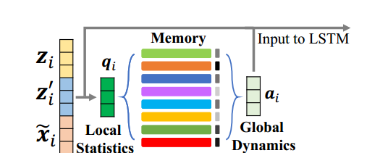
Proposed Solution
Memory Module with global data
For every time-interval, query the memory module for global data
Module learns global patterns
Query by local context
Empirical Mean
Last Observation
How long since last observation

Slide 8
Proposed Solution
Memory Module with global data
For every time-interval, query the memory module for global data
Module learns global patterns
Query by local context
Empirical Mean
Last Observation
How long since last observation
LSTM Module
Combine local and global data into the LSTM to preserve long-term dependencies
Cannot deal with missing values, therefor combining global and local is key

Slide 9
Proposed Solution
Adversarial Training
For better accuracy when missing rate increases
Consists of a generator and discriminator
Generates good «fake data» when the miss rate is high

Slide 10
Results Experimental Settings
4 Datasets
Beijing air pollution
PhysioNet (clinical health data time series)
PortoTaxi
LondonWeather
Benchmark Algorithms
Linear Regression
XGBoost
MICE
GRUI
GRU-D
BRITS

Slide 11
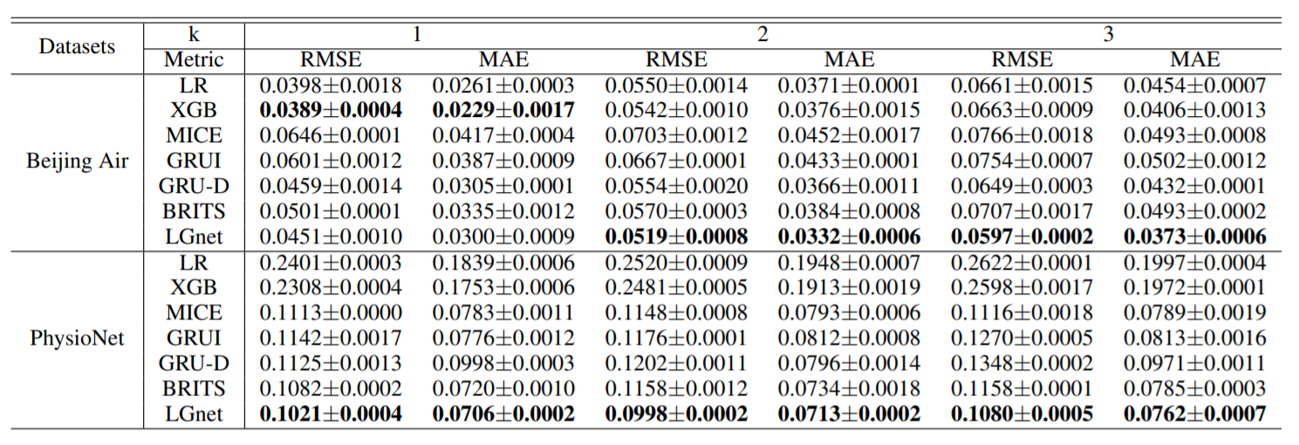
Results
RQ1: Can LGnet improve the accuracy of MTS forecasting with missing values?
Performs better than others on short term and especially long term forecasting PhysioNet has value missing ratio over over 70% and here the results are significantly better than other algorithms

Slide 12
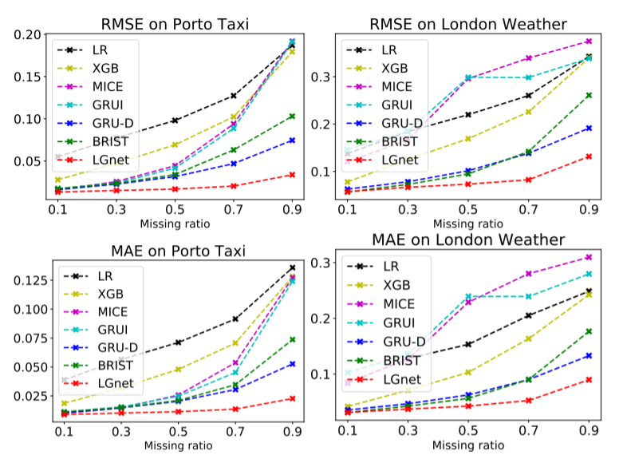
Results
RQ2: How robust is LGnet w.r.t different missing ratios?
Significantly more robust to missing values ratio. Note how the other algorithms struggled when the ratio approaches 0.9

Slide 13
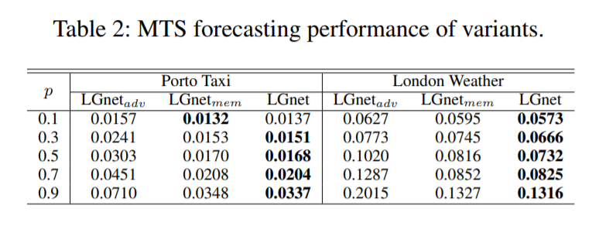
Results
RQ3: How the memory module benefits LGnet?
RQ4: How adversarial training contributes to LGnet?
Memory Module increases the performance Adversarial training increases the performance!

Slide 14
Conclusion
SOTA architecture in LGNet
Outperforms other architectures and techniques at the time of publication

Slide 15
Discussions and Questions

